Slide 1

21CSC206T– Artificial Intelligence
UNIT – 2
PREPAED BY
Dr N.Saranya

Slide 2
Unit 2 List of Topics
Searching techniques – Uninformed search – General search Algorithm
Uninformed search Methods – Breadth First Search
Uninformed search Methods – Depth First Search
Uninformed search Methods – Depth limited Search
Uniformed search Methods- Iterative Deepening search
Bi-directional search
Informed search- Generate and test, Best First search
Informed search-A* Algorithm
AO* research
Local search Algorithms-Hill Climbing, Simulated Annealing
Local Beam Search
Genetic Algorithms
Adversarial search Methods-Game playing-Important concepts
Game playing and knowledge structure.
Game as a search problem-Minimax Approach
Minimax Algorithm
Alpha beta pruning
Game theory problems

Slide 3
search
Finding appropriate option,
Search discovers or locates path.
control strategy :=search process and possesses some knowledge to get the outcome

Slide 4
General Search Strategies
Blind search → traversing the search space until the goal nodes is found (might be doing exhaustive search).
Techniques : Breadth First, Depth first, Depth Limited, Iterative Deepening search, Uniform Cost search.
Guarantees solution.
Heuristic search → search process takes place by traversing search space with applied rules (information).
Techniques: Greedy Best First Search, A* Algorithm
There is no guarantee that solution is found.

Slide 5
search strategies
Uninformed: Use only information available in the problem formulation
Breadth-first
Uniform-cost
Depth-first
Depth-limited
Iterative deepening
Informed: Use heuristics to guide the search
Best first
Greedy search
A*

Slide 6
GENERAL SEARCH ALGORITHM
Searching for solutions
Problem solving agents
Control strategies
Parameters for search evaluation

Slide 7
Searching for solutions
State space-finding path
State space-collection of all possible configurations
[S,A,I,G]-state space search-process of starting the state space for solution to reach the goal.

Slide 8
Algorithm

Slide 9
Problem solving agent
Agent –formulate the goal as well the problem
Entity that can perceive the environment and act on it.

Slide 10
Control strategies
How to reach or what way to follow while searching for a solution
The most common startegies
Forward search
Backward Search
Systematic Search –when search space is small.
depth and Breadth first search
Its also called blind search
Heuristic Search –based on previous experience

Slide 11
Evaluation of search strategies
Search algorithms are commonly evaluated according to the following four criteria:
Completeness: does it always find a solution if one exists?
Time complexity: how long does it take as a function of number of nodes?
Space complexity: how much memory does it require?
Optimality: does it guarantee the least-cost solution?
Time and space complexity are measured in terms of:
b – max branching factor of the search tree
d – depth of the least-cost solution
m – max depth of the search tree (may be infinity)

Slide 12
Last time: uninformed search strategies
Uninformed search:
Use only information available in the problem formulation
Breadth-first
Uniform-cost
Depth-first
Depth-limited
Iterative deepening

Slide 13
Breadth first search (BFS)
It follows the shallow node approach
Search technique where from the root node ,all successors are searched across level
Queue data structures is used to carry out the search

Slide 14
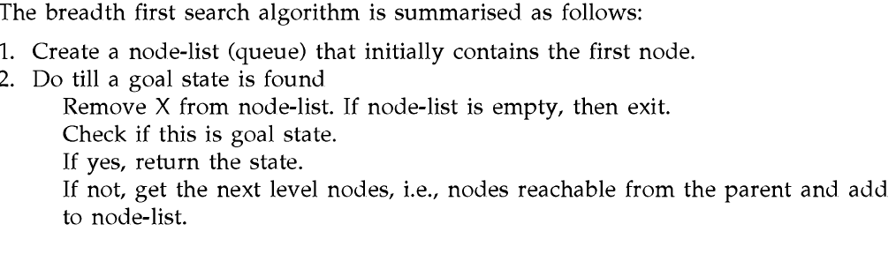
BFS ALGORITHM

Slide 15
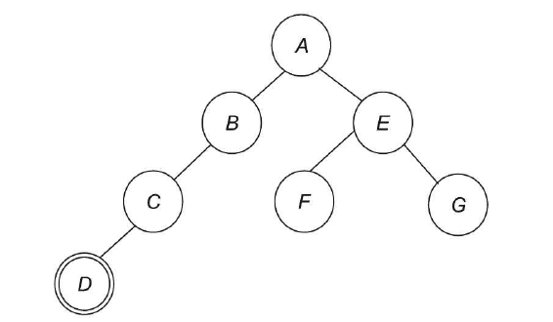
Time complexity (b)=O(b^{d}) and space complexity=O(b^{d})
Cost of every edge is same.b =branching tool

Slide 17
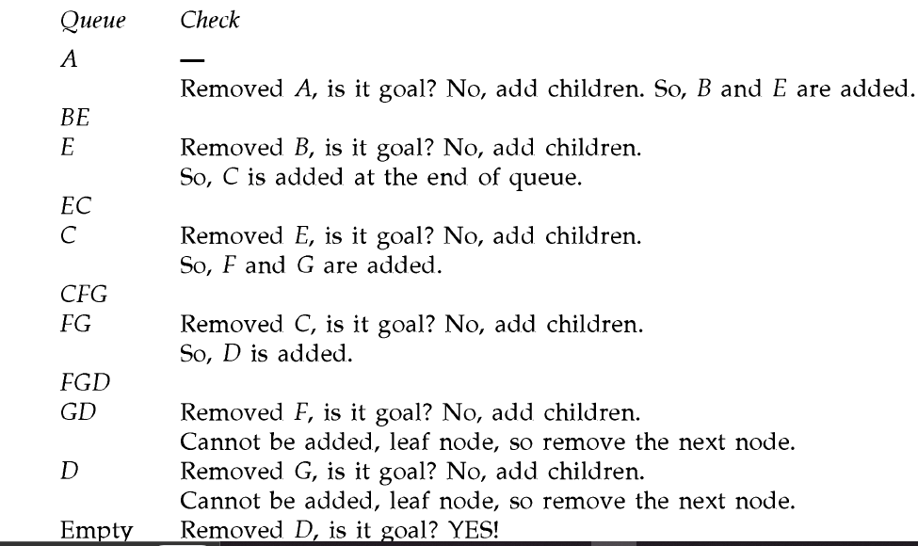
STEPS

Slide 18
Important Terms
Search space → possible conditions and solutions.
Initial state → state where the searching process started.
Goal state → the ultimate aim of searching process.
Problem space → “what to solve”
Searching strategy →strategy for controlling the search.
Search tree → tree representation of search space, showing possible solutions from initial state.

Slide 19
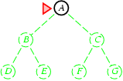
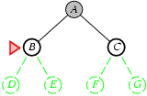
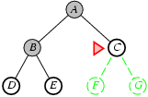
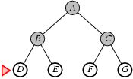
Blind Search : Breadth First Search
1
2
3
4

Slide 20
Blind strategies BFS
Blind Search : Breadth First Search
Search Methods
BFS characteristics
Completeness: if the branching factor is ‘b’ and the goal node is at depth d, BFS will eventually find it.
Optimality: BFS is optimal if path cost is a non-decreasing function of depth.ª
Time complexity:
1 + b + b² + b³ + . . . + b^{d} + b(b^{d} − 1) = O(b^{d+1}).
Space complexity: O(b^{d+1}).^{b}
ª Otherwise, the shallowest node may not necessarily be optimal.
^{b}b branching factor; d depth of the goal node
spring 2011

Slide 21
Uniform cost search
Every edge cost associated with it.
If all the edges do not have same cost,BFS generalizes to uniform cost search.
At each step ,next thing to be performed expands/selects a node X ,whose cost c(x)is lowest,
C(x)=sum of cost of edges from root to the node.
Implemented using priority queue
Mostly it explores large trees

Slide 22
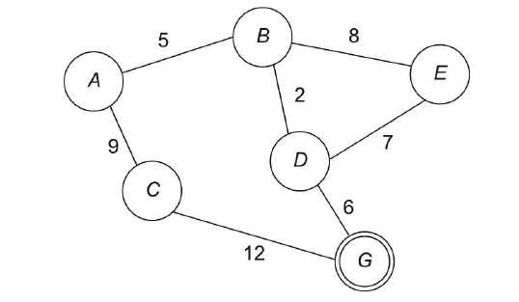
Example-uniform cost search

Slide 23
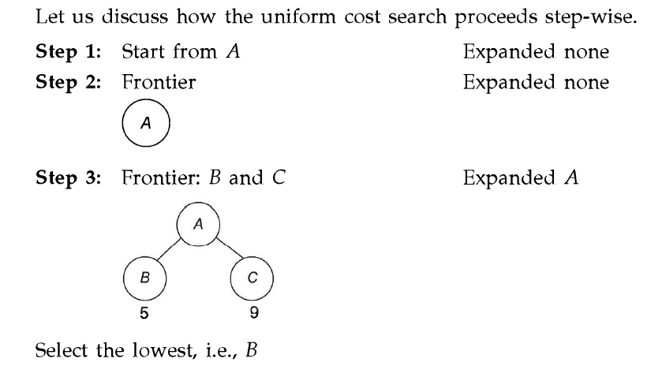

Slide 24
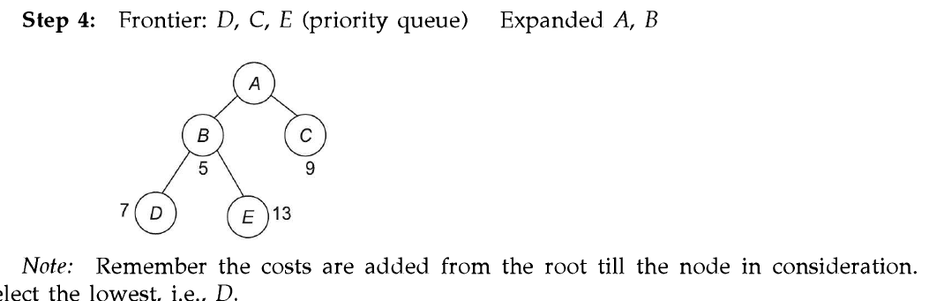

Slide 25
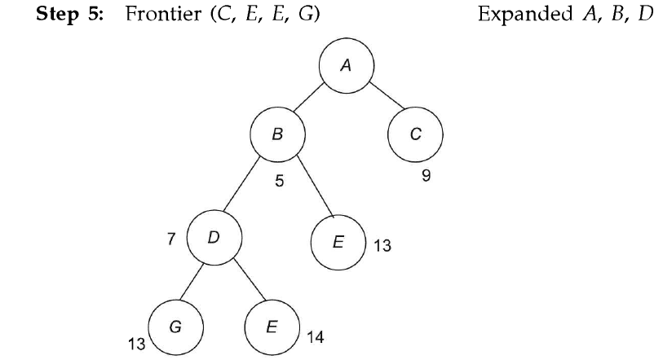

Slide 26
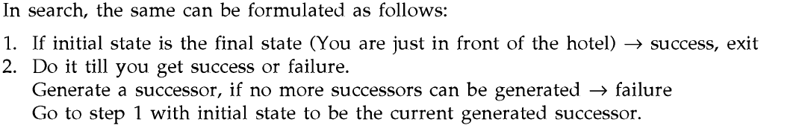
Depth first search
Single branch of the tree is considered at a time
Backtracking
Stack data structure is used .

Slide 27
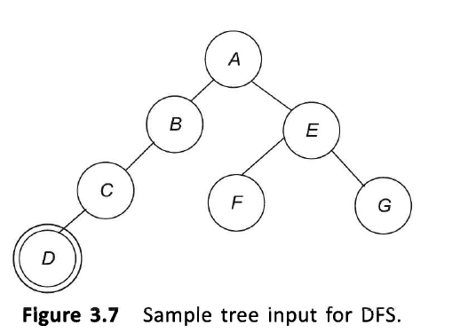
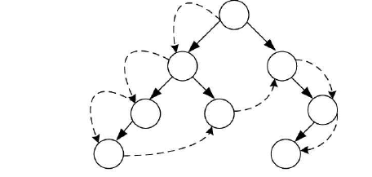

Slide 28
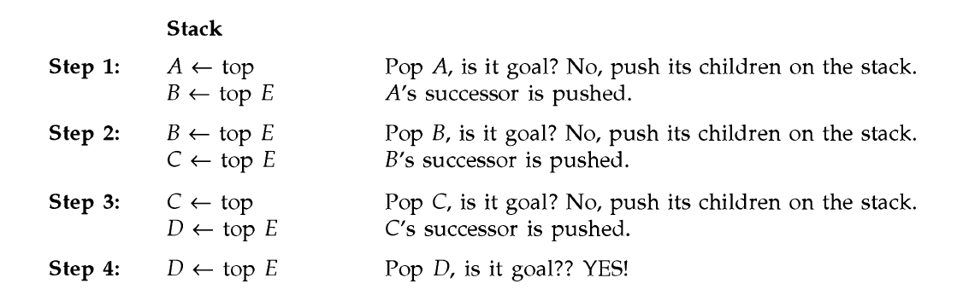

Slide 29
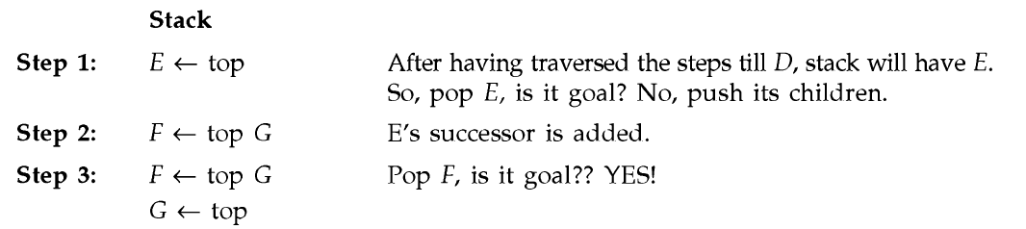
Goal state:To reach F
Intial s,working is same as the way to reach to D.
Next step needs backtracking and hence it starts with E.

Slide 30
Path =A-E-F
At any point of time needs to keep the path from the root to the current node .O(b^{d})

Slide 31
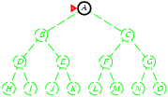
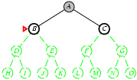
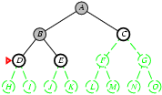
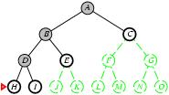
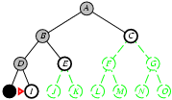
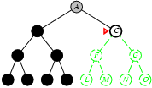
Blind Search : Depth First Search (DFS)
Implementation:
fringe = LIFO queue, i.e., put successors at front.
1
2
3
4
5
N+1
…….

Slide 32
Blind Search : Depth First Search (DFS)
Search Methods
DFS characteristics
Small space requirements: only the path to the current node and the siblings of each node in the path are stored.
Backtracking search generates only one successor for each node.
Completeness: no, if the expanded subtree has an infinite depth.
Optimality: no, if a solution located deeper, but located in a subtree expanded earlier, is found.
Time complexity: O(b ).
Space complexity: O(bm) (linear!).
m
spring 2011

Slide 33
BFS Vs DFS
ADVANTAGES OF DFS | ADVANTAGES OF BFS
Simple to implement | Guaranteed to find a solution(if one exists)
Needs relatively small memory fo storing the state space | Depending on the problem ,can be guaranteed to find an optimal solution
Cannot find solution in all cases and hence can sometimes fail to find a solution | Memory management along with allocation is the key factor and hence more complex to implement
Not guaranteed to find an optimal solution can take a lot of time to find a solution | Needs a lot of memory for storing the state space is the search space has a high branching factor

Slide 34
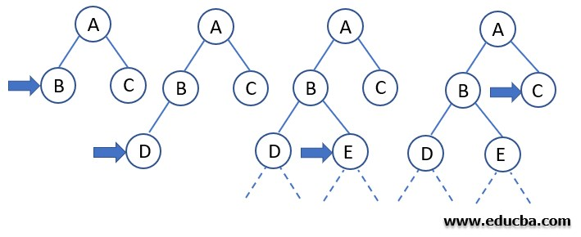
Blind Search : Depth Limited Search (DLS)
Search Methods
In Depth Limited Search, we first set a constraint on how deep (or how far from root) will we go.
In the above example , If we fix the depth limit to 2, DLS can be carried out similarly to the DFS until the goal node is found to exist in the search domain of the tree.
spring 2011

Slide 35
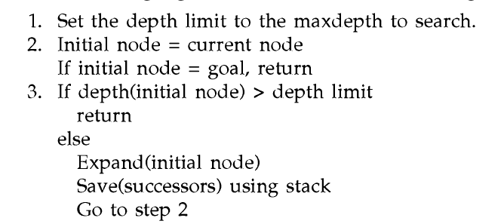
Algorithm

Slide 36
There is no guarantee that search will give solution that will be optimal, it finds the one which is within its limits

Slide 37
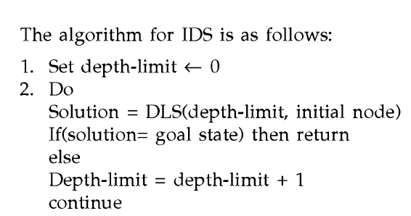
ITEREATIVE DEEPENING SEARCH
Enhanced version of depth limited search .
Iterative deepening helps in addressing such problems.
Extend the limit by limit=limit+1

Slide 38
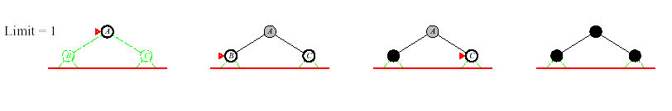
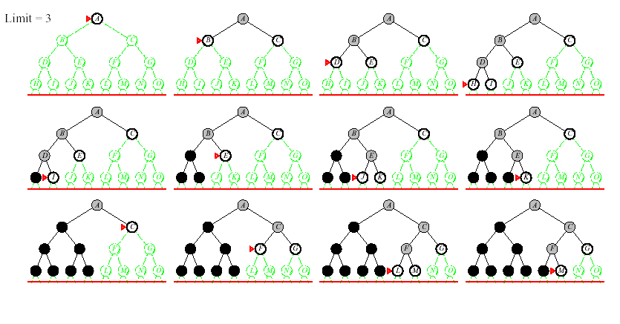
Blind Search : Iterative Deepening DFS (ID-DFS)
DEPTH LIMITED SEARCH

Slide 39
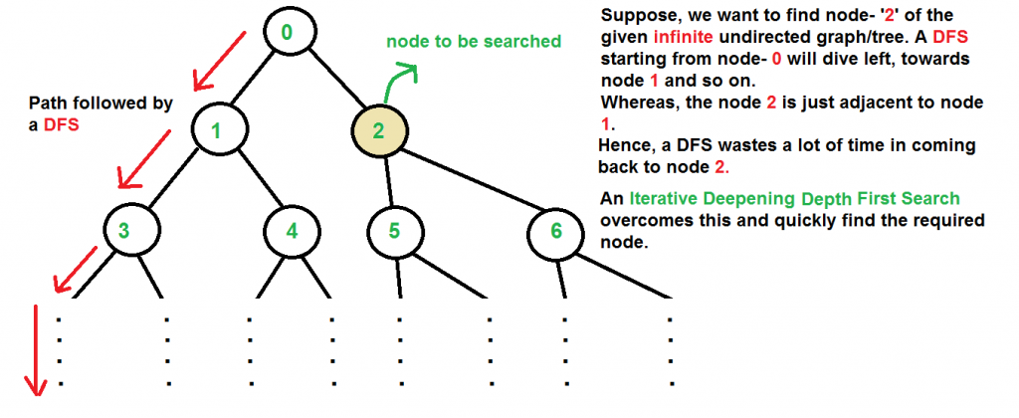
Blind Search : Iterative Deepening DFS (ID-DFS)

Slide 40
Blind Search : Iterative Deepening DFS (ID-DFS)
Search Methods
IDS characteristics
Completeness: yes.
Optimality: yes, if step cost = 1. Time complexity:
(d + 1)b⁰ + db¹ + (d − 1)b² + . . . + b^{d} = O(b^{d} ).
Space complexity: O(bd).
Numerical comparison for b = 10, d = 5
N(IDS ) = 50 + 400 + 3000 + 20000 + 100000 = 123450
N(BFS) = 10 + 100 + 1000 + 10000 + 100000 + 999990 = 1111100
Conclusion
IDS exhibits better performance, because it does not expand other nodes at depth d.

Slide 41

APPLICATION: MAZE GAME
HOW TO REACH TO THE GOAL?

Slide 42


APPLICATION: MAZE GAME
BFS SOLUTION?
S-1-2-3-5-8-10-12-14-16-19-G
SEARCH SOLUTION FOUND IN 12 STEPS
DFS SOLUTION?
S-1-2-3-6-5-8-9-10-11-13-16-18-G
SEARCH SOLUTION FOUND IN 14 STEPS

Slide 43
APPLICATION: MAZE GAME
BFS SOLUTION?
S-1-2-3-5-8-10-12-14-16-19-G
SEARCH SOLUTION FOUND IN 12 STEPS
S
5
15
19
6
7
8
1
17
18
G
21
9
10
2
20
21
11
12
x
3
x
19
5
4
13
14
16
15
19

Slide 44
APPLICATION: MAZE GAME
BFS SOLUTION?
S-1-2-3-5-8-10-12-14-16-19-G
SEARCH SOLUTION FOUND IN 12 STEPS
S
5
15
19
6
7
8
1
17
18
G
21
9
10
2
20
21
11
12
x
3
x
19
5
4
13
14
16
15
19

Slide 45
Blind Search : Uniform Cost Search
This algorithm comes into play when a different cost is available for each edge.
The primary goal of the uniform-cost search is to find a path to the goal node which has the lowest cumulative cost.
Uniform-cost search expands nodes according to their path costs form the root node. It can be used to solve any graph/tree where the optimal cost is in demand.
A uniform-cost search algorithm is implemented by the priority queue.
It gives maximum priority to the lowest cumulative cost.
Uniform cost search is equivalent to BFS algorithm if the path cost of all edges is the same.

Slide 46
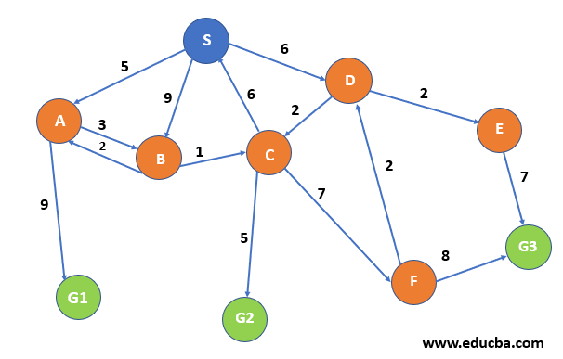
Uniform Cost Search - Example

Slide 47
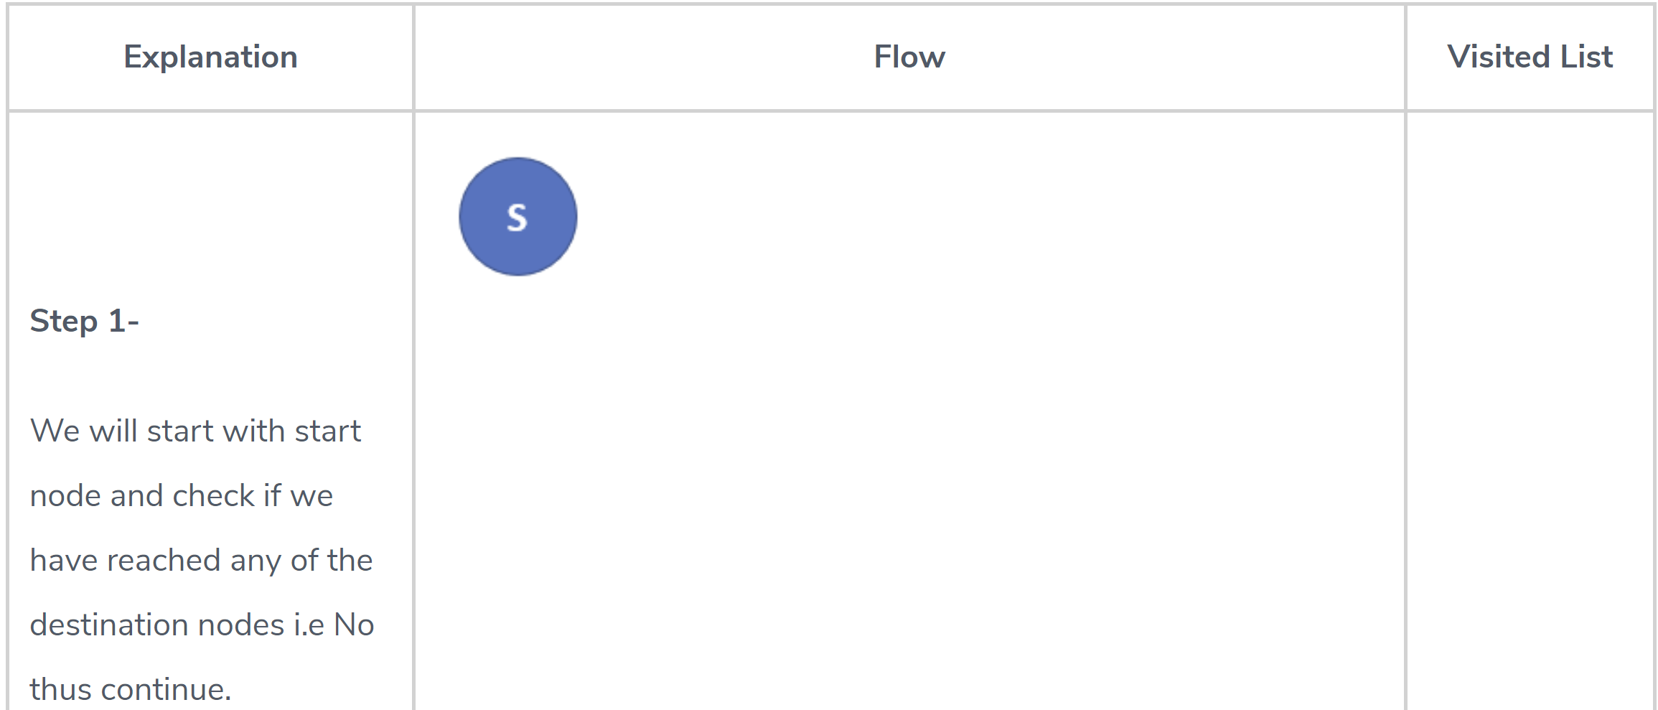
Uniform Cost Search - Example

Slide 48
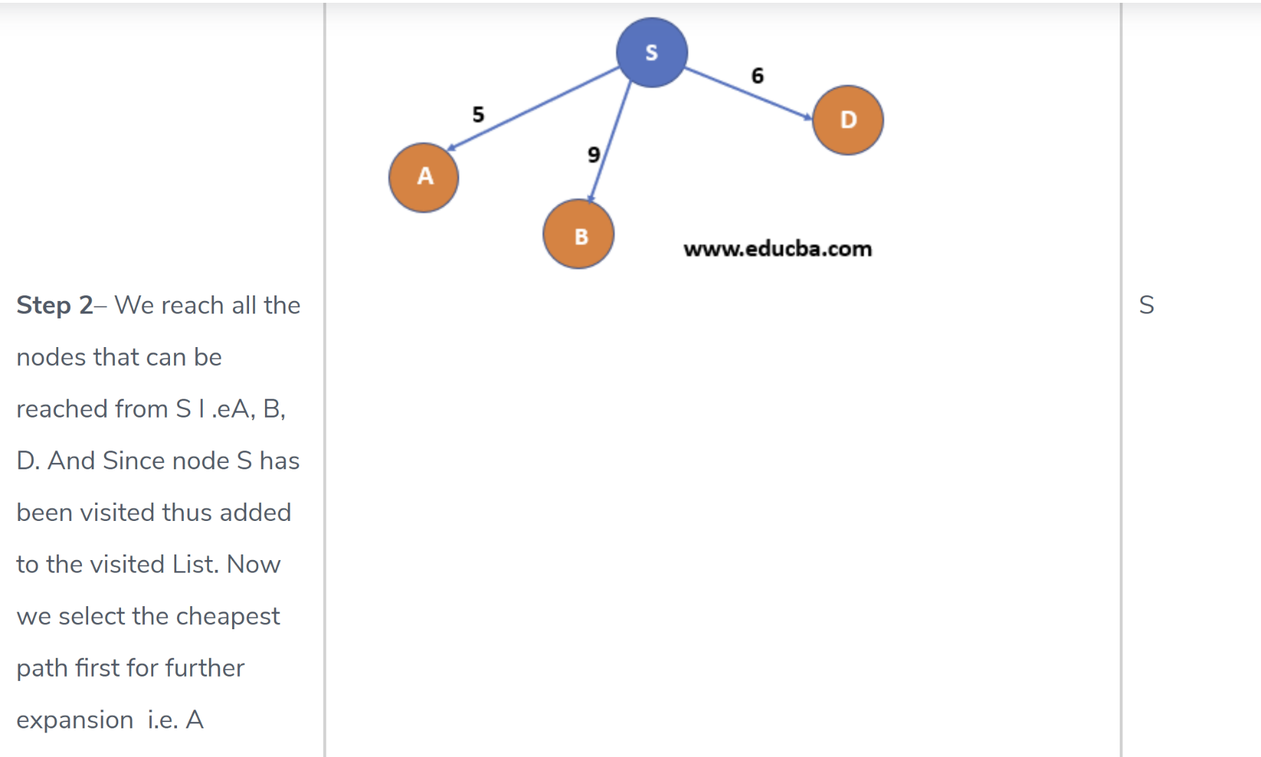
Uniform Cost Search - Example

Slide 49
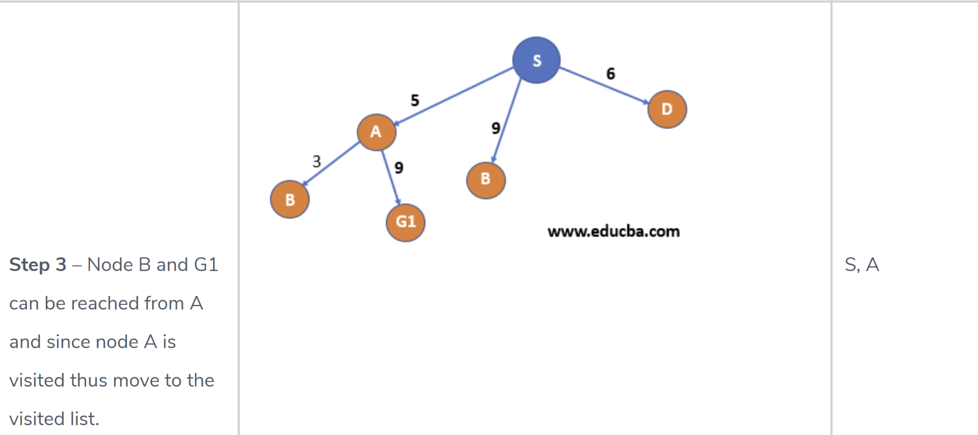
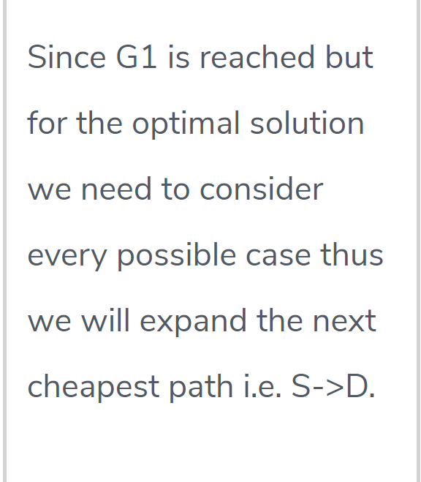
Uniform Cost Search - Example

Slide 50
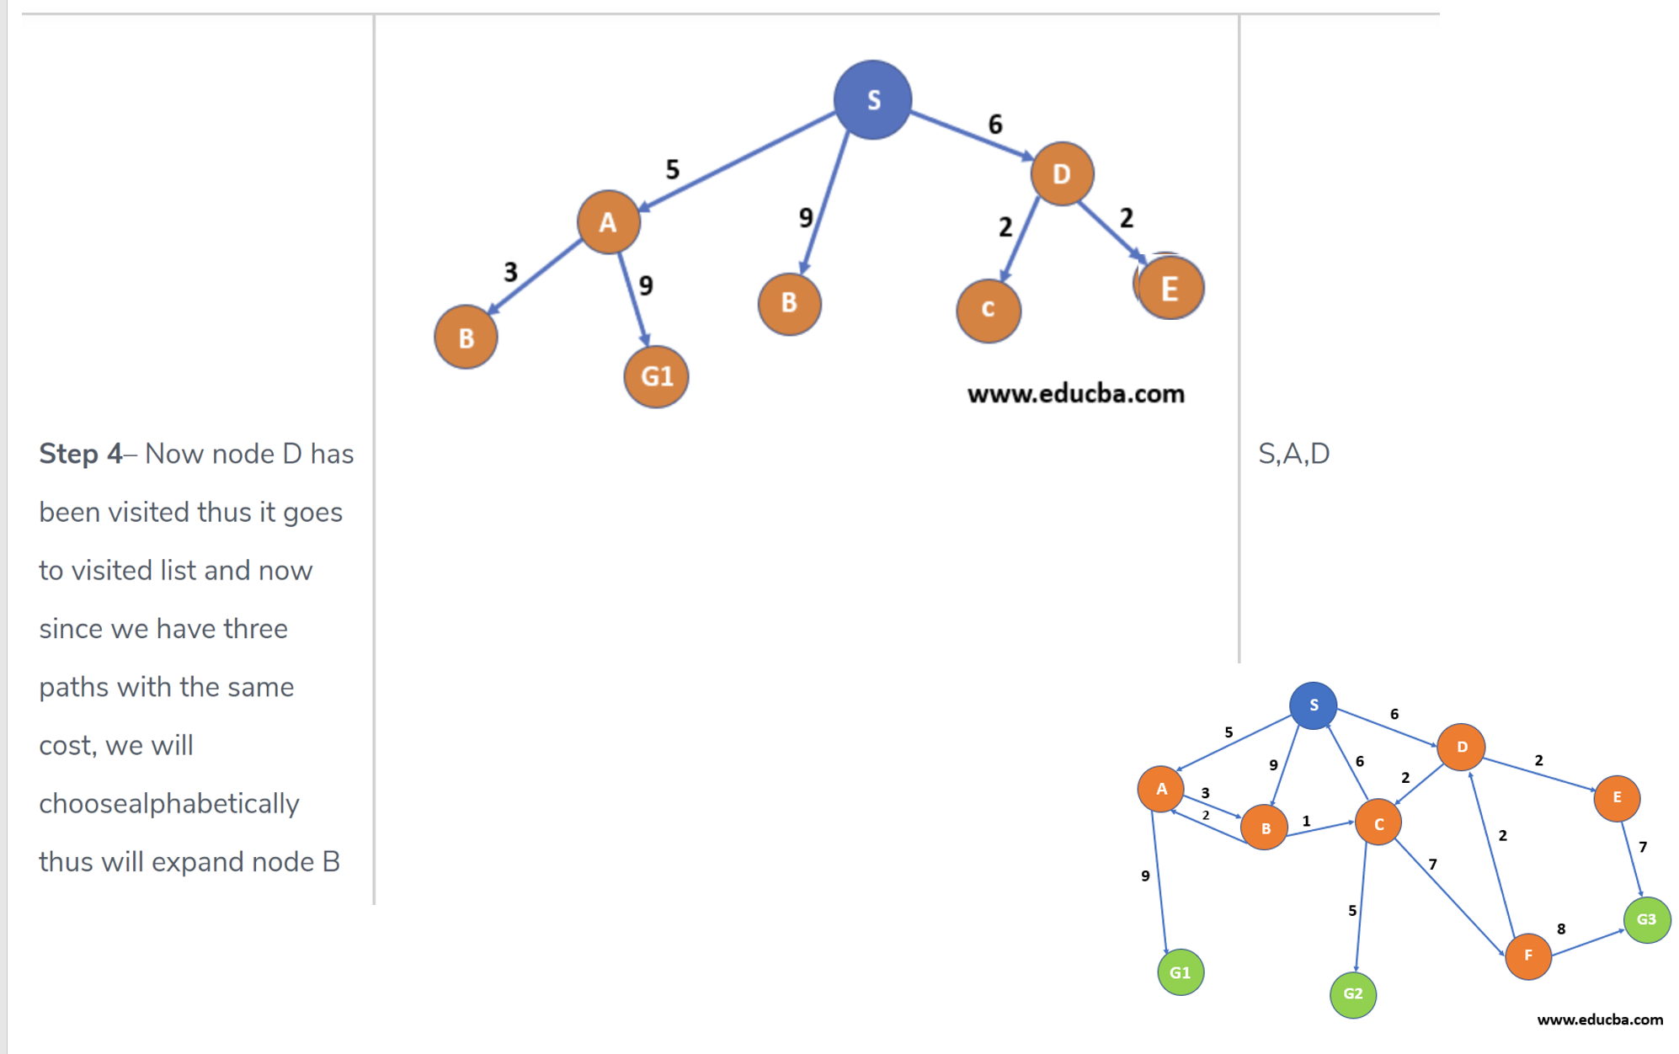
Uniform Cost Search - Example

Slide 51
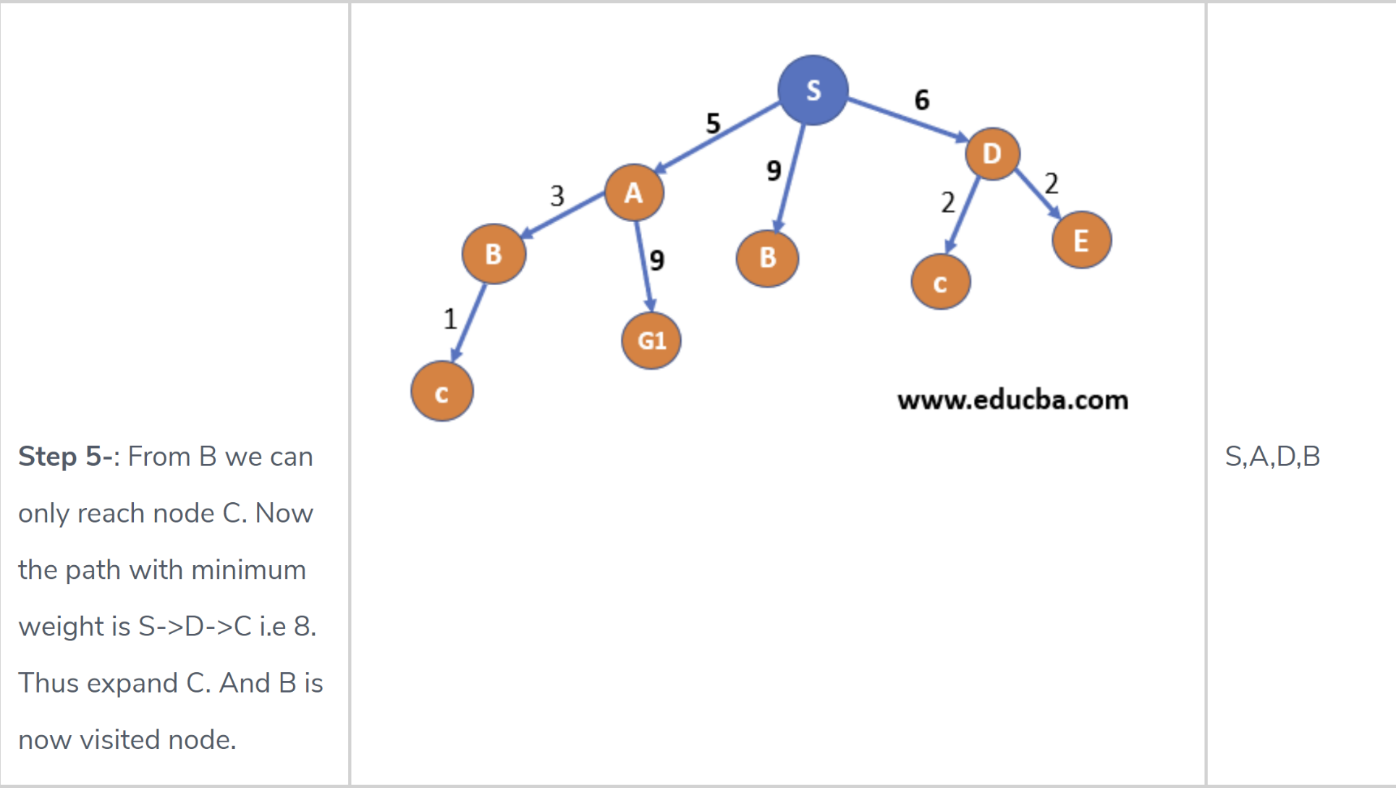
Uniform Cost Search - Example

Slide 52
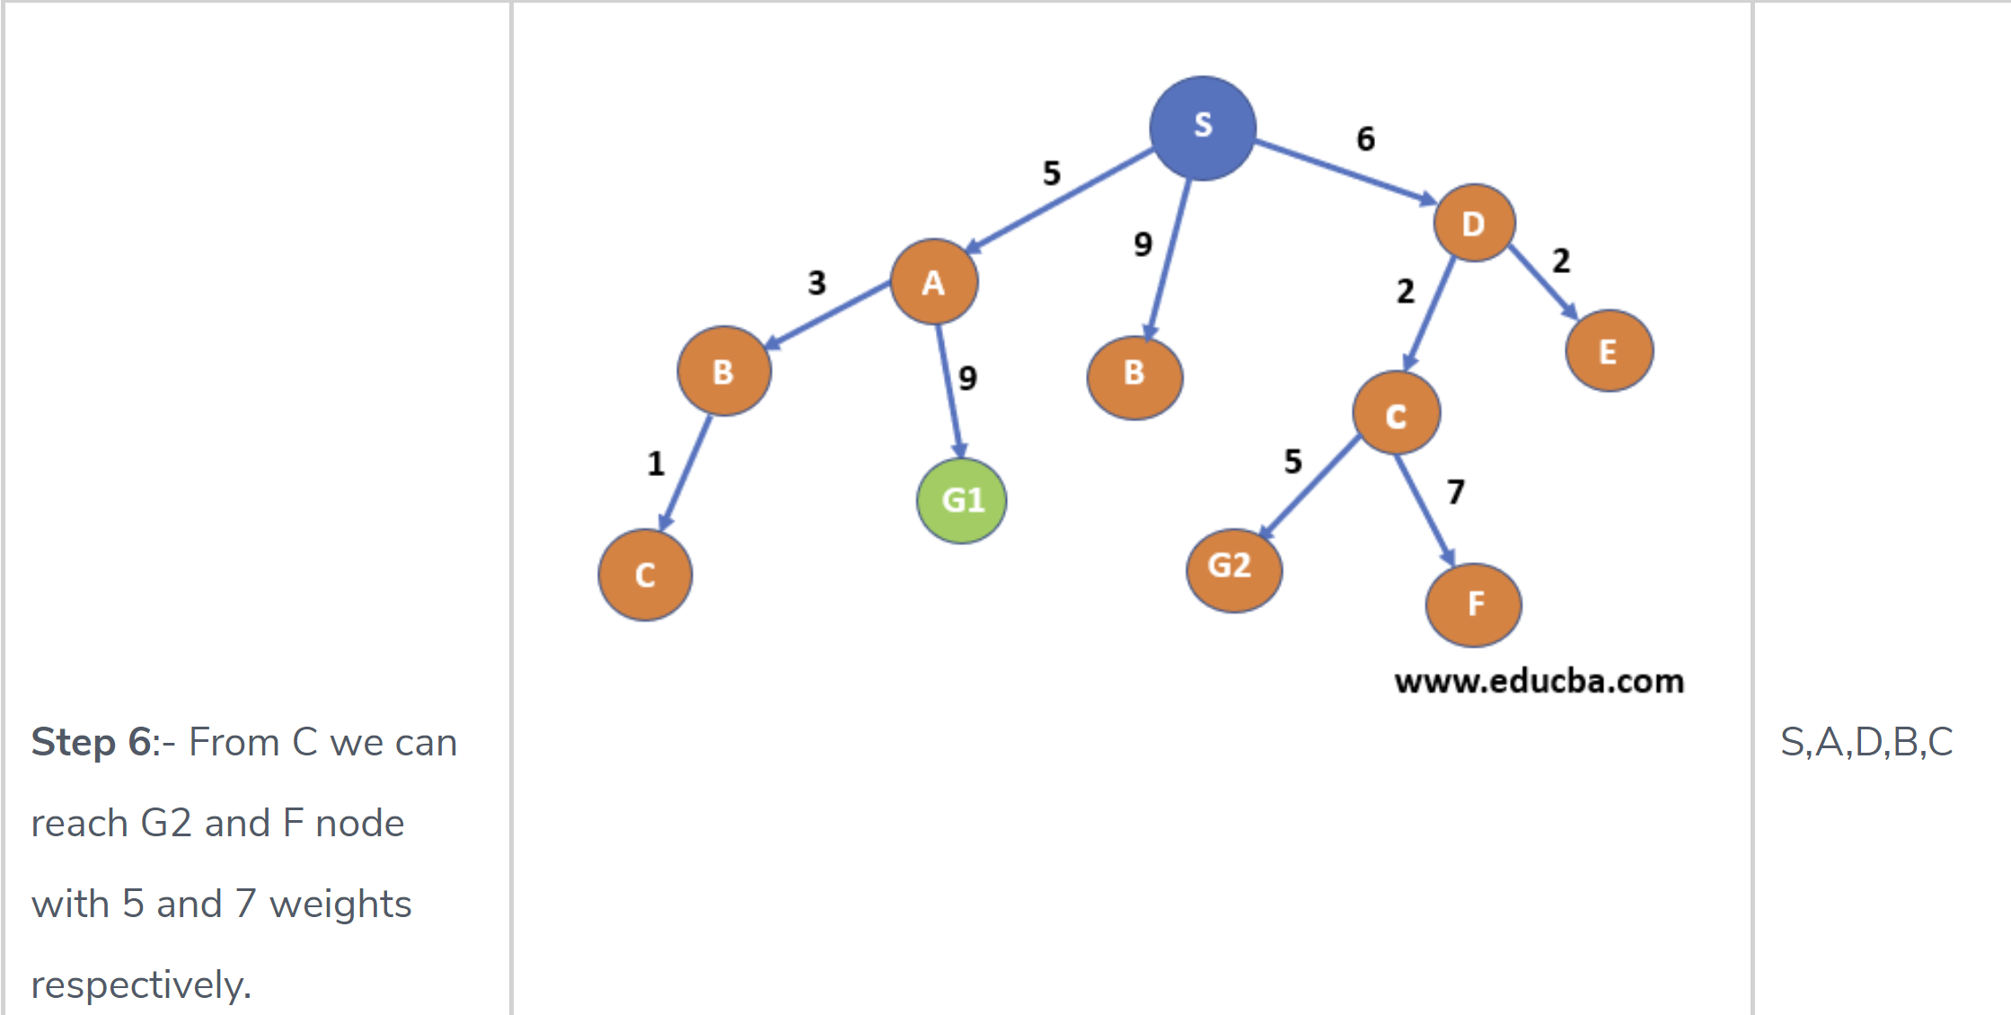
Uniform Cost Search - Example

Slide 53
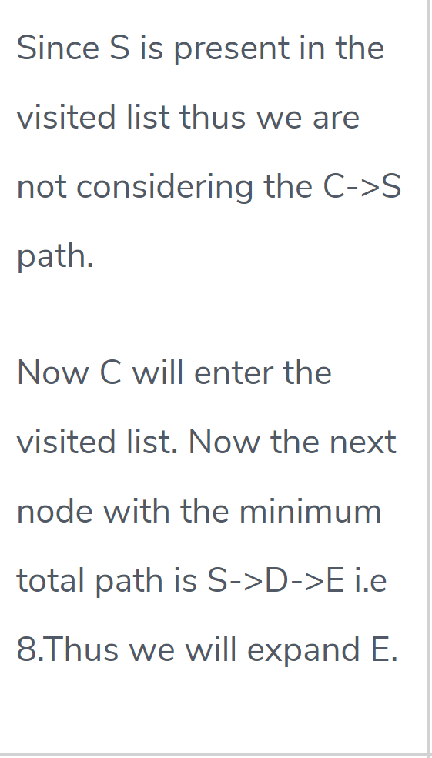
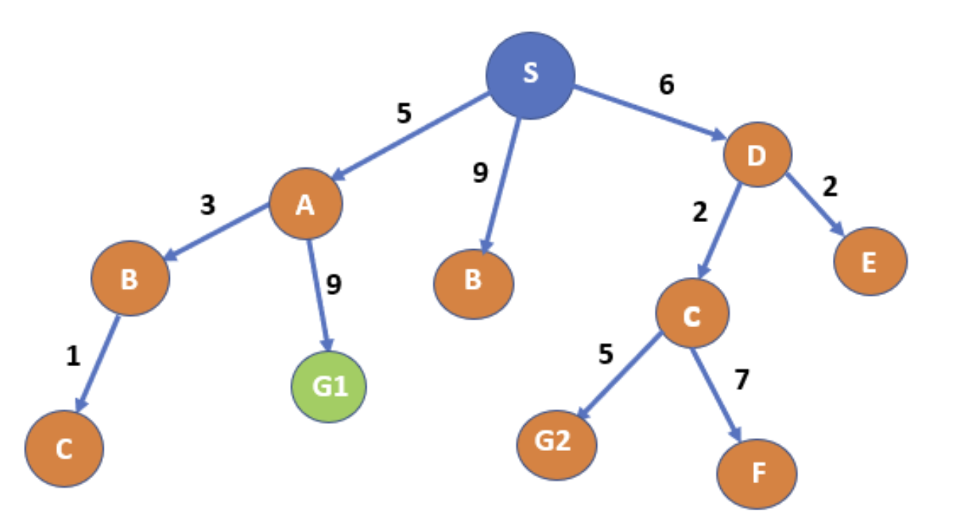
Uniform Cost Search - Example

Slide 54
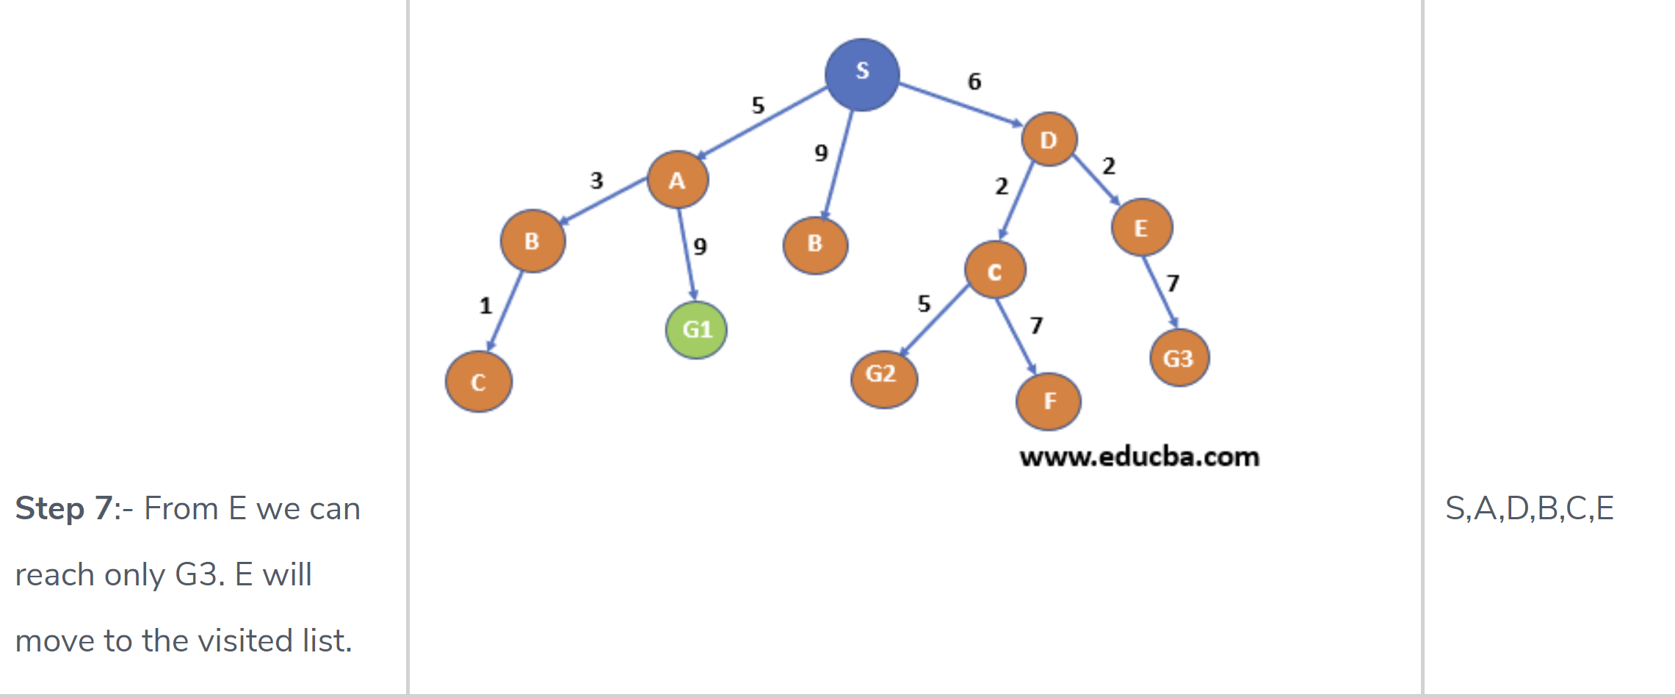
Uniform Cost Search - Example

Slide 55
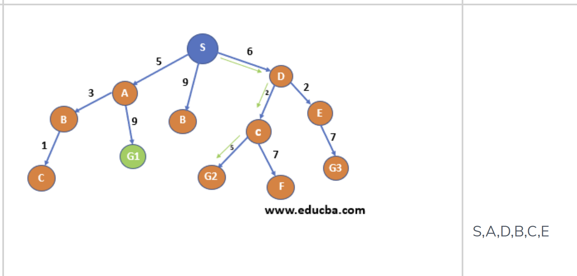
Uniform Cost Search - Example
Minimum is S->D->C->G2
And also G2 is one of the destination nodes thus we found our path.
In this way we can find the path with the minimum cumulative cost from a start node to ending node – S->D->C->G2 with cost total cost as 13(marked with green color).

Slide 56
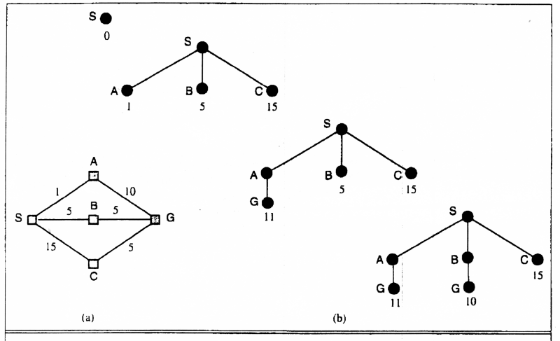
Uniform Cost Search
Implementation: fringe = queue ordered by path cost
Equivalent to breadth-first if all step costs all equal.
Breadth-first is only optimal if step costs is increasing with depth.
(e.g. constant). Can we guarantee optimality for any step cost?
Uniform-cost Search: Expand node with smallest path cost g(n).

Slide 57
Blind strategies UCS
Uniform Cost Search
Search Methods
Uniform-cost search strategy
Expands the node with the lowest cost from the start node
rst.ª
Completeness: yes, if cost of each step ≥ s > 0.
Optimality: same as above nodes are expanding in increasing order of cost.
Time and space complexity: O(b^{1+ƒC ∗/s¶}).^{b}
a
If all step costs are equal, UCS=BFS. C ∗ cost of optimal solution
b

Slide 58
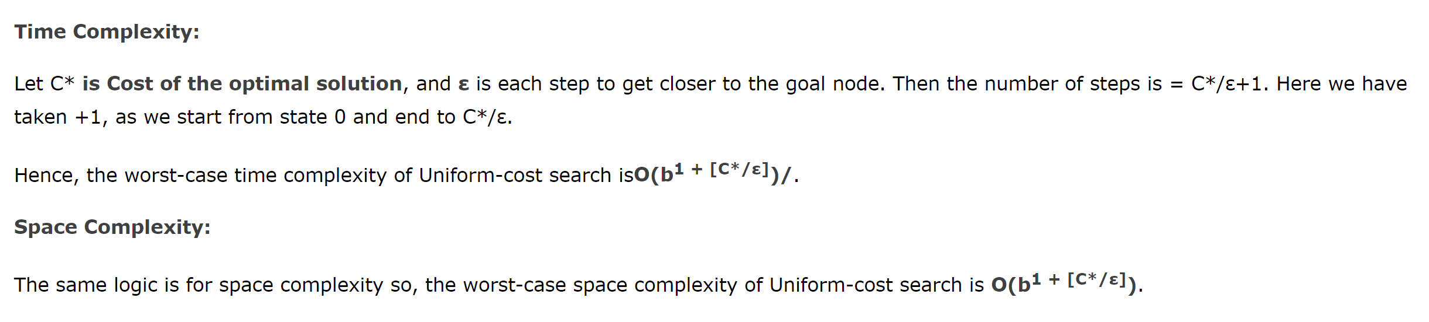
Blind strategies UCS
Uniform Cost Search
Search Methods

Slide 59
Bi directional search
The search is carried out from both ends an we are unsure of getting solution
It comparises
Forward search-from initial stage to goal
Backward search
Its not necessary bi directional search always uses BFS as a path to search.
It could be with best first or other methods too.
It can be part of heuristics

Slide 60
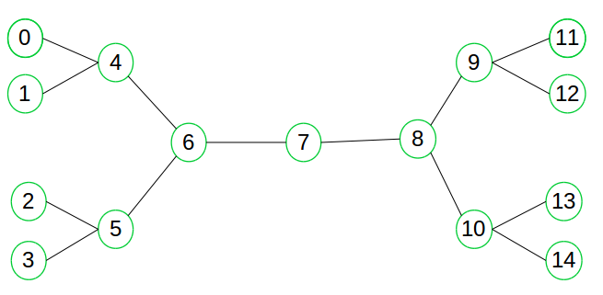
Blind search -Bidirectional Search

Slide 61




Summary of Blind Search Algorithms
Criterion | Breadth- First | Depth- First
Time | _{b}d | _{b}m
Space | _{b}d | bm
Optimal? | Yes | No
Complete? | Yes | No
b: branching factor
d: solution depth
m: maximum depth

Slide 62
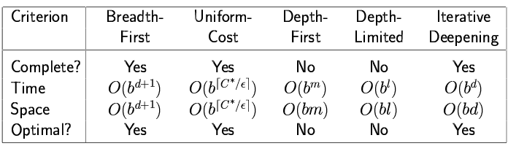
Summary of Blind Search Algorithms
Algorithm | Space | Time | Complete | Optimal
BFS | Theta (b^d) | Theta(b^d) | Yes | Yes
DFS | Theta(d) | Theta(b^m) | No | No
UCS | Theta(b^ (ceil(C*/e)) | Theta(b^d) | Yes | Yes
DLS | Theta(l) | Theta(b^l) | No | No
IDS | Theta(d) | Theta(b^d) | Yes | Yes

Slide 63
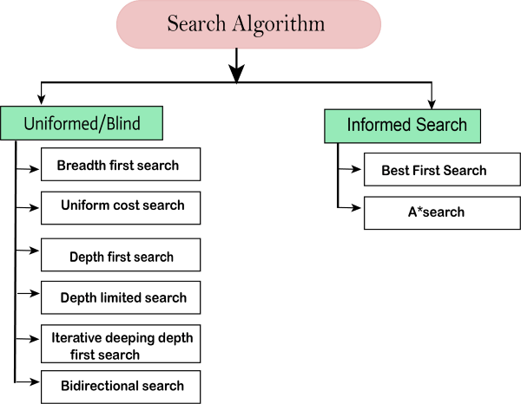
Summary of Search Algorithms

Slide 64
Informed Search Algorithms
Generate and Test
Best-first search
Greedy best-first search
A* search
Heuristics

Slide 65
Generate-and-test
Very simple strategy - just keep guessing.
do while goal not accomplished
generate a possible solution
test solution to see if it is a goal
Heuristics may be used to determine the specific rules for solution generation.
Notes:
Generating a solution may mean moving in the state space, or perhaps constructing a path through the state space. The path may end at a goal state, in which case we are done.
If a systematic mechanism for generation is used the algorithm can always find the best solution.
Random generation may work in some domains.
Depth first search since complete solutions are generated before they can be tested.

Slide 66
Example - Traveling Salesman Problem (TSP)
Generate-and-test
Traveler needs to visit n cities.
Know the distance between each pair of cities.
Want to know the shortest route that visits all the cities once.
n=80 will take millions of years to solve exhaustively!

Slide 67
TSP Example
Generate-and-test
A
B
6
1
2
5
3
D
C
4
Notes:
ABCD = 18
BACD = 13 - take it
ABCD = 18 - nope
BCAD - 11 - take it (is the optimum)
CBAD - 18
BACD - 13
BCDA - 18
DCAB - 13 nope

Slide 68
Generate-and-test Example
TSP - generation of possible solutions is done in lexicographical order of cities:
1. A - B - C - D
2. A - B - D - C
3. A - C - B - D
4. A - C - D - B
...
A
B
C
D
B
C
D
C
D
B
D
C
B
D
C
D
B
B
C
Notes:
Characteristics with generate-and-test:
Requires that an entire possible solution is generated at each step, which may
be expensive
It may be difficult to develop a generation scheme that provides a
good order.
The big problem is that the algorithm is blind - it does not make use of any
knowledge that becomes available during the search.
1. Can modify to use brand-and-bound techniques to skip some solutions.
2. Perhaps we can use information about the likelyhood of success to change
the generated possible solutions.
IMPORTANT: TSP is a bad example because it is hard to see the state space. Consider a problem like the water jug problem and describe how this algorithm would work in that domain.

Slide 69
Best First Search Algorithms
Idea: use an evaluation function f(n) for each node
f(n) provides an estimate for the total cost.
Expand the node n with smallest f(n).
Implementation:
Order the nodes in fringe increasing order of cost.
Special cases:
greedy best-first search
A* search

Slide 70
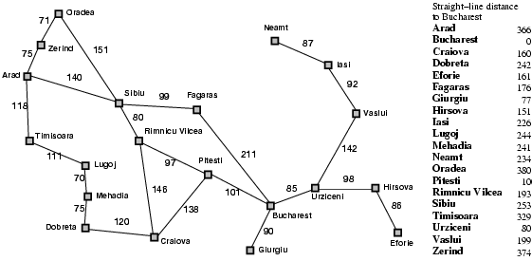
Romania with straight-line dist.

Slide 71
Greedy best-first search
f(n) = estimate of cost from n to goal
e.g., f(n) = straight-line distance from n to Bucharest
Greedy best-first search expands the node that appears to be closest to goal.

Slide 72

Greedy best-first search example

Slide 73
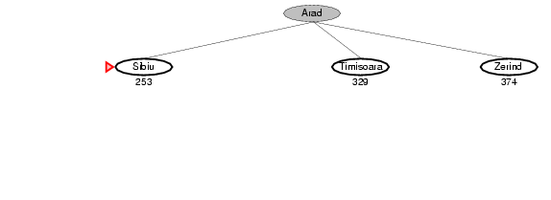
Greedy best-first search example

Slide 74
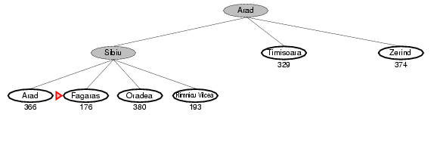
Greedy best-first search example

Slide 75
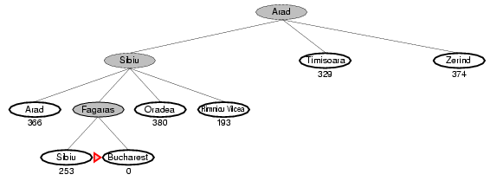
Greedy best-first search example

Slide 76
Properties of greedy best-first search
Complete? No – can get stuck in loops.
Time? O(b^{m}), but a good heuristic can give dramatic improvement
Space? O(b^{m}) - keeps all nodes in memory
Optimal? No
e.g. Arad→Sibiu→Rimnicu Virea→Pitesti→Bucharest is shorter!

